Slide 1



TaskFlow AI Chat Demo: Organize Work Effortlessly
Discover how TaskFlow AI revolutionizes project management by instantly transforming your requests into actionable task lists. Experience the future of organized work.

Slide 2
See TaskFlow AI in Action: Your Smart Project Assistant
Witness firsthand how TaskFlow AI streamlines your workflow, turning complex project ideas into clear, manageable steps with intelligent automation.

Slide 3

User Request: Simplify Your College Project Planning
The demo begins with a user typing a natural language request:
“Create a task list for my college project about the most famous projects for frontend developers.”
TaskFlow AI intelligently parses this request, understanding both the immediate need for a task list and the specific domain knowledge required for frontend development.

Slide 4
Instant AI-Powered Task Generation
TaskFlow AI immediately processes the request and generates a comprehensive, step-by-step task list. Each task is meticulously crafted to be actionable and relevant to the "most famous projects for frontend developers."
Project Research
Technology Stack Analysis
Identify iconic frontend projects and their core technologies.
Document popular frameworks, libraries, and tools used.
Case Study Development
Presentation Outline
Create detailed case studies for 2-3 chosen projects.
Structure your findings into a compelling presentation flow.

Slide 5
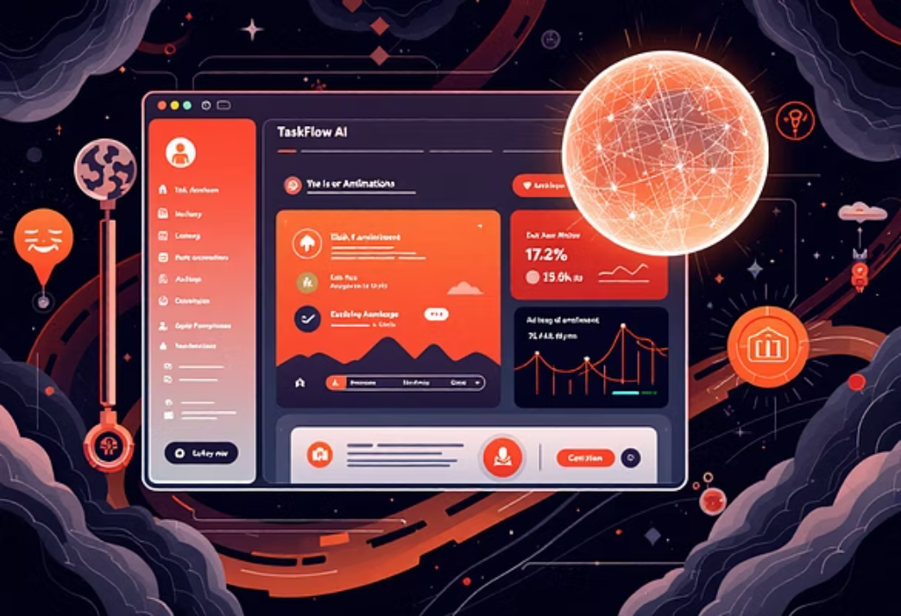

Dynamic UI Animation: Watch Tasks Come to Life
As TaskFlow AI generates the tasks, the user interface provides engaging visual feedback. Each task item animates into place, creating a dynamic and satisfying experience that highlights the AI's efficiency and responsiveness.

Slide 6

The Power of TaskFlow’s Chat Interface
TaskFlow's chat interface ensures a seamless, real-time interaction with the AI. It maintains a persistent conversation history, allowing users to refine requests or ask follow-up questions without losing context. This intuitive design, powered by Streamlit’s ChatUI component, makes task management feel natural and effortless.

Slide 7

Why TaskFlow AI Stands Out
TaskFlow AI isn't just a chatbot; it's a sophisticated task management system built on advanced AI principles.
Modular AI Agents
Flexible & Lightweight
Multi-Agent Collaboration
Dedicated AI agents collaborate to ensure precise and comprehensive task completion, handling specific aspects of your requests.
Designed for maximum productivity, TaskFlow AI focuses on delivering actionable results without unnecessary complexity.
Supports seamless integration with various tools and multi-agent workflows, enabling solutions for even the most complex projects.

Slide 8
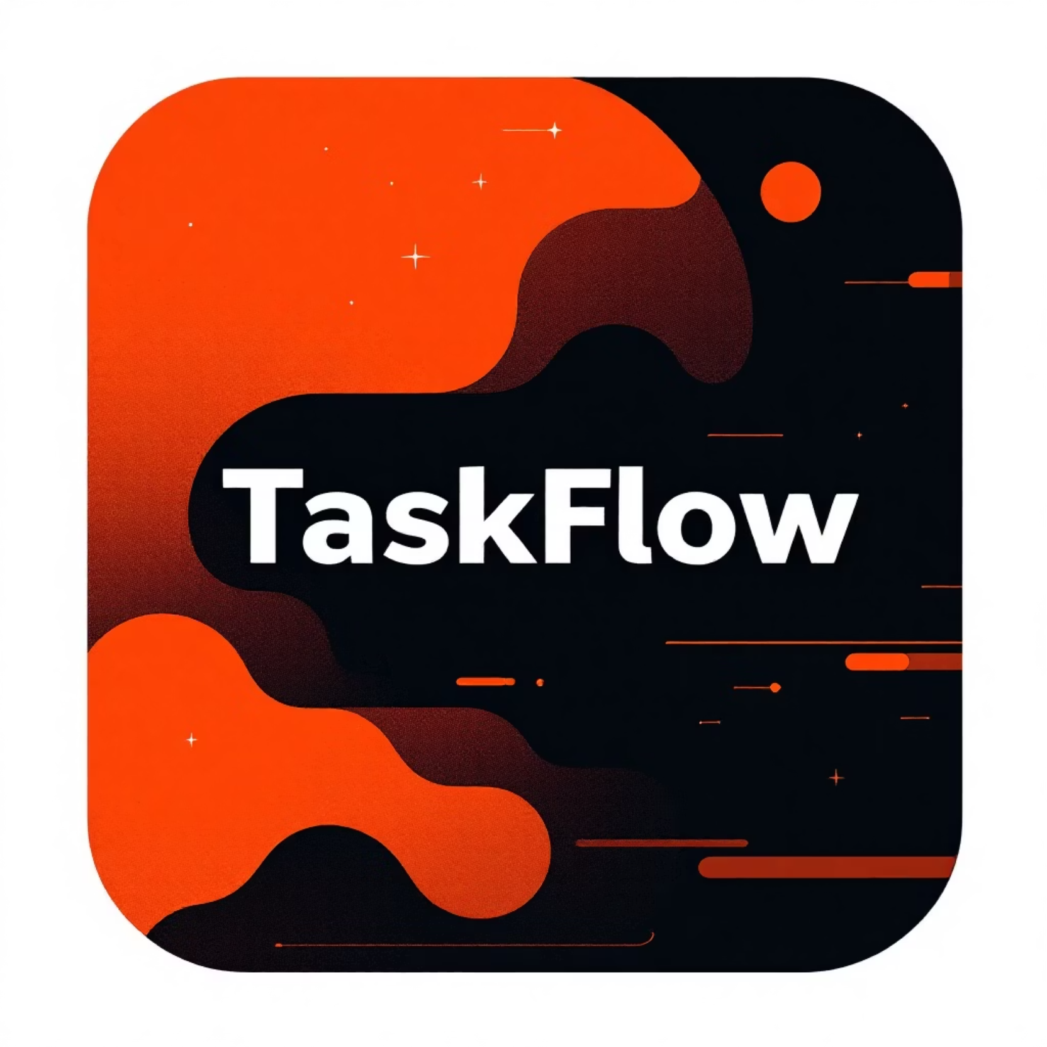
Brand Presence: TaskFlow Logo & Tagline
Organize Work Effortlessly
The demo concludes with a powerful final screen, prominently featuring the TaskFlow logo. This reinforces our commitment to intelligent automation and efficient project organization.
The tagline, "Organize work effortlessly," encapsulates our core mission and promises a seamless user experience.

Slide 9



How This Demo Benefits You
TaskFlow AI empowers you to achieve more with less effort. See how it can transform your daily productivity.
Time Savings
Leverage AI-driven guidance to save valuable time on planning and focus on execution.
Quick Task Generation
Instantly create structured task lists for any project, from academic assignments to professional endeavors.
Engaging Experience
Enjoy a visual and interactive workflow that boosts engagement and makes task management intuitive.

Slide 10
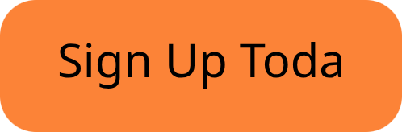
Ready to Experience TaskFlow AI?
Don't just read about it—experience the future of task management. Visit our landing page to try the live demo now and discover how effortless project organization can truly be.
Join the growing community of professionals and students who are streamlining their work and achieving more with TaskFlow AI.

